Slide 1



SALES ANALYTIC FOR RETAIL / FMCG
Datawiz Inc.

Slide 2



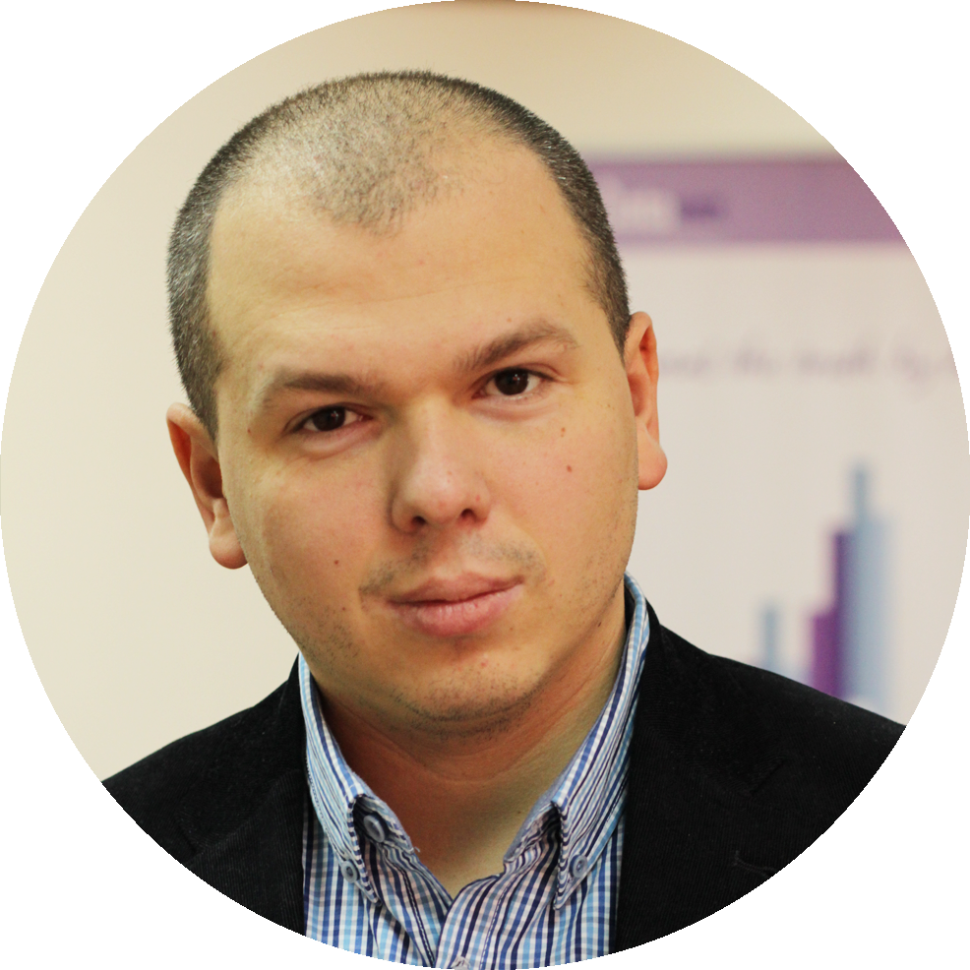




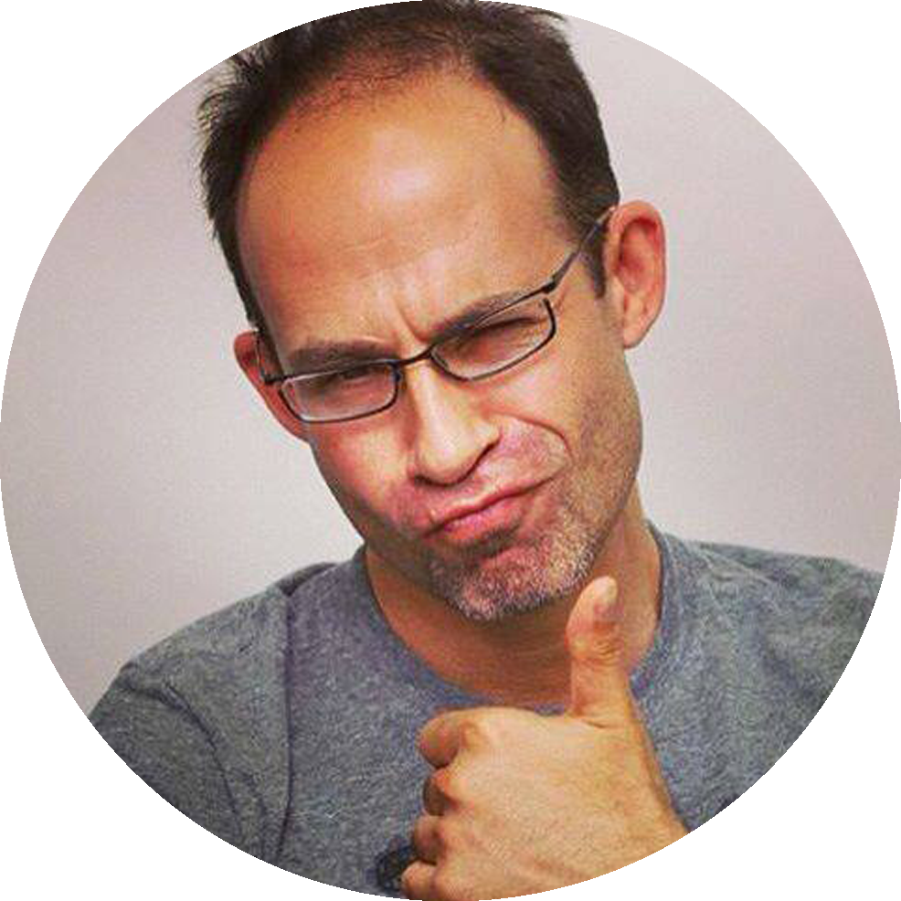
Our Team
ђ
Xiang Ting
(CEO Datawiz.io)
Volodymyr Nepiuk
(CTO Datawiz.io)
Igor Ryabenkiy
(mentor, Managing
Partner at Altair Capital)
Laurent Gil
(mentor, exCEO Viewdel)
Jonathan Romley
(mentor, exCTO Viewdel,
CEO Avarla)
Igor Shoifot
(mentor, TMT Investments)
Viewdel was aquired by Google

Slide 3



Investment
$ 75 000
from Happy Farm
(US/Ukrainian incubator)
seed investment from
Russian venture fund
Altair Capital
$ 100 000

Slide 4

Our Mission
Understanding and predicting of consumers around the world

Slide 5

Our Technology
MACHINE LEARNING
PREDICTIVE ANALYSIS
TIME SERIES ANALYSIS
DATA MINING
APRIORI ALGORITHM
CLOUD COMPUTING
CLUSTERING

Slide 6

Our Products can
Monitor all stores in real time
Visualize real-time sales data
Help increase sales
Optimize product assortment
Build price elasticity
Plan marketing activities
Improve of product layout

Slide 7

Our Solutions
BI Datawiz.io
Business intelligence based on
real time transactional data
Datawiz Mobile Application
SMS Reporting Services
Datawiz Clustering Engine
Defining customer persona
Omni-channel approaching

Slide 8
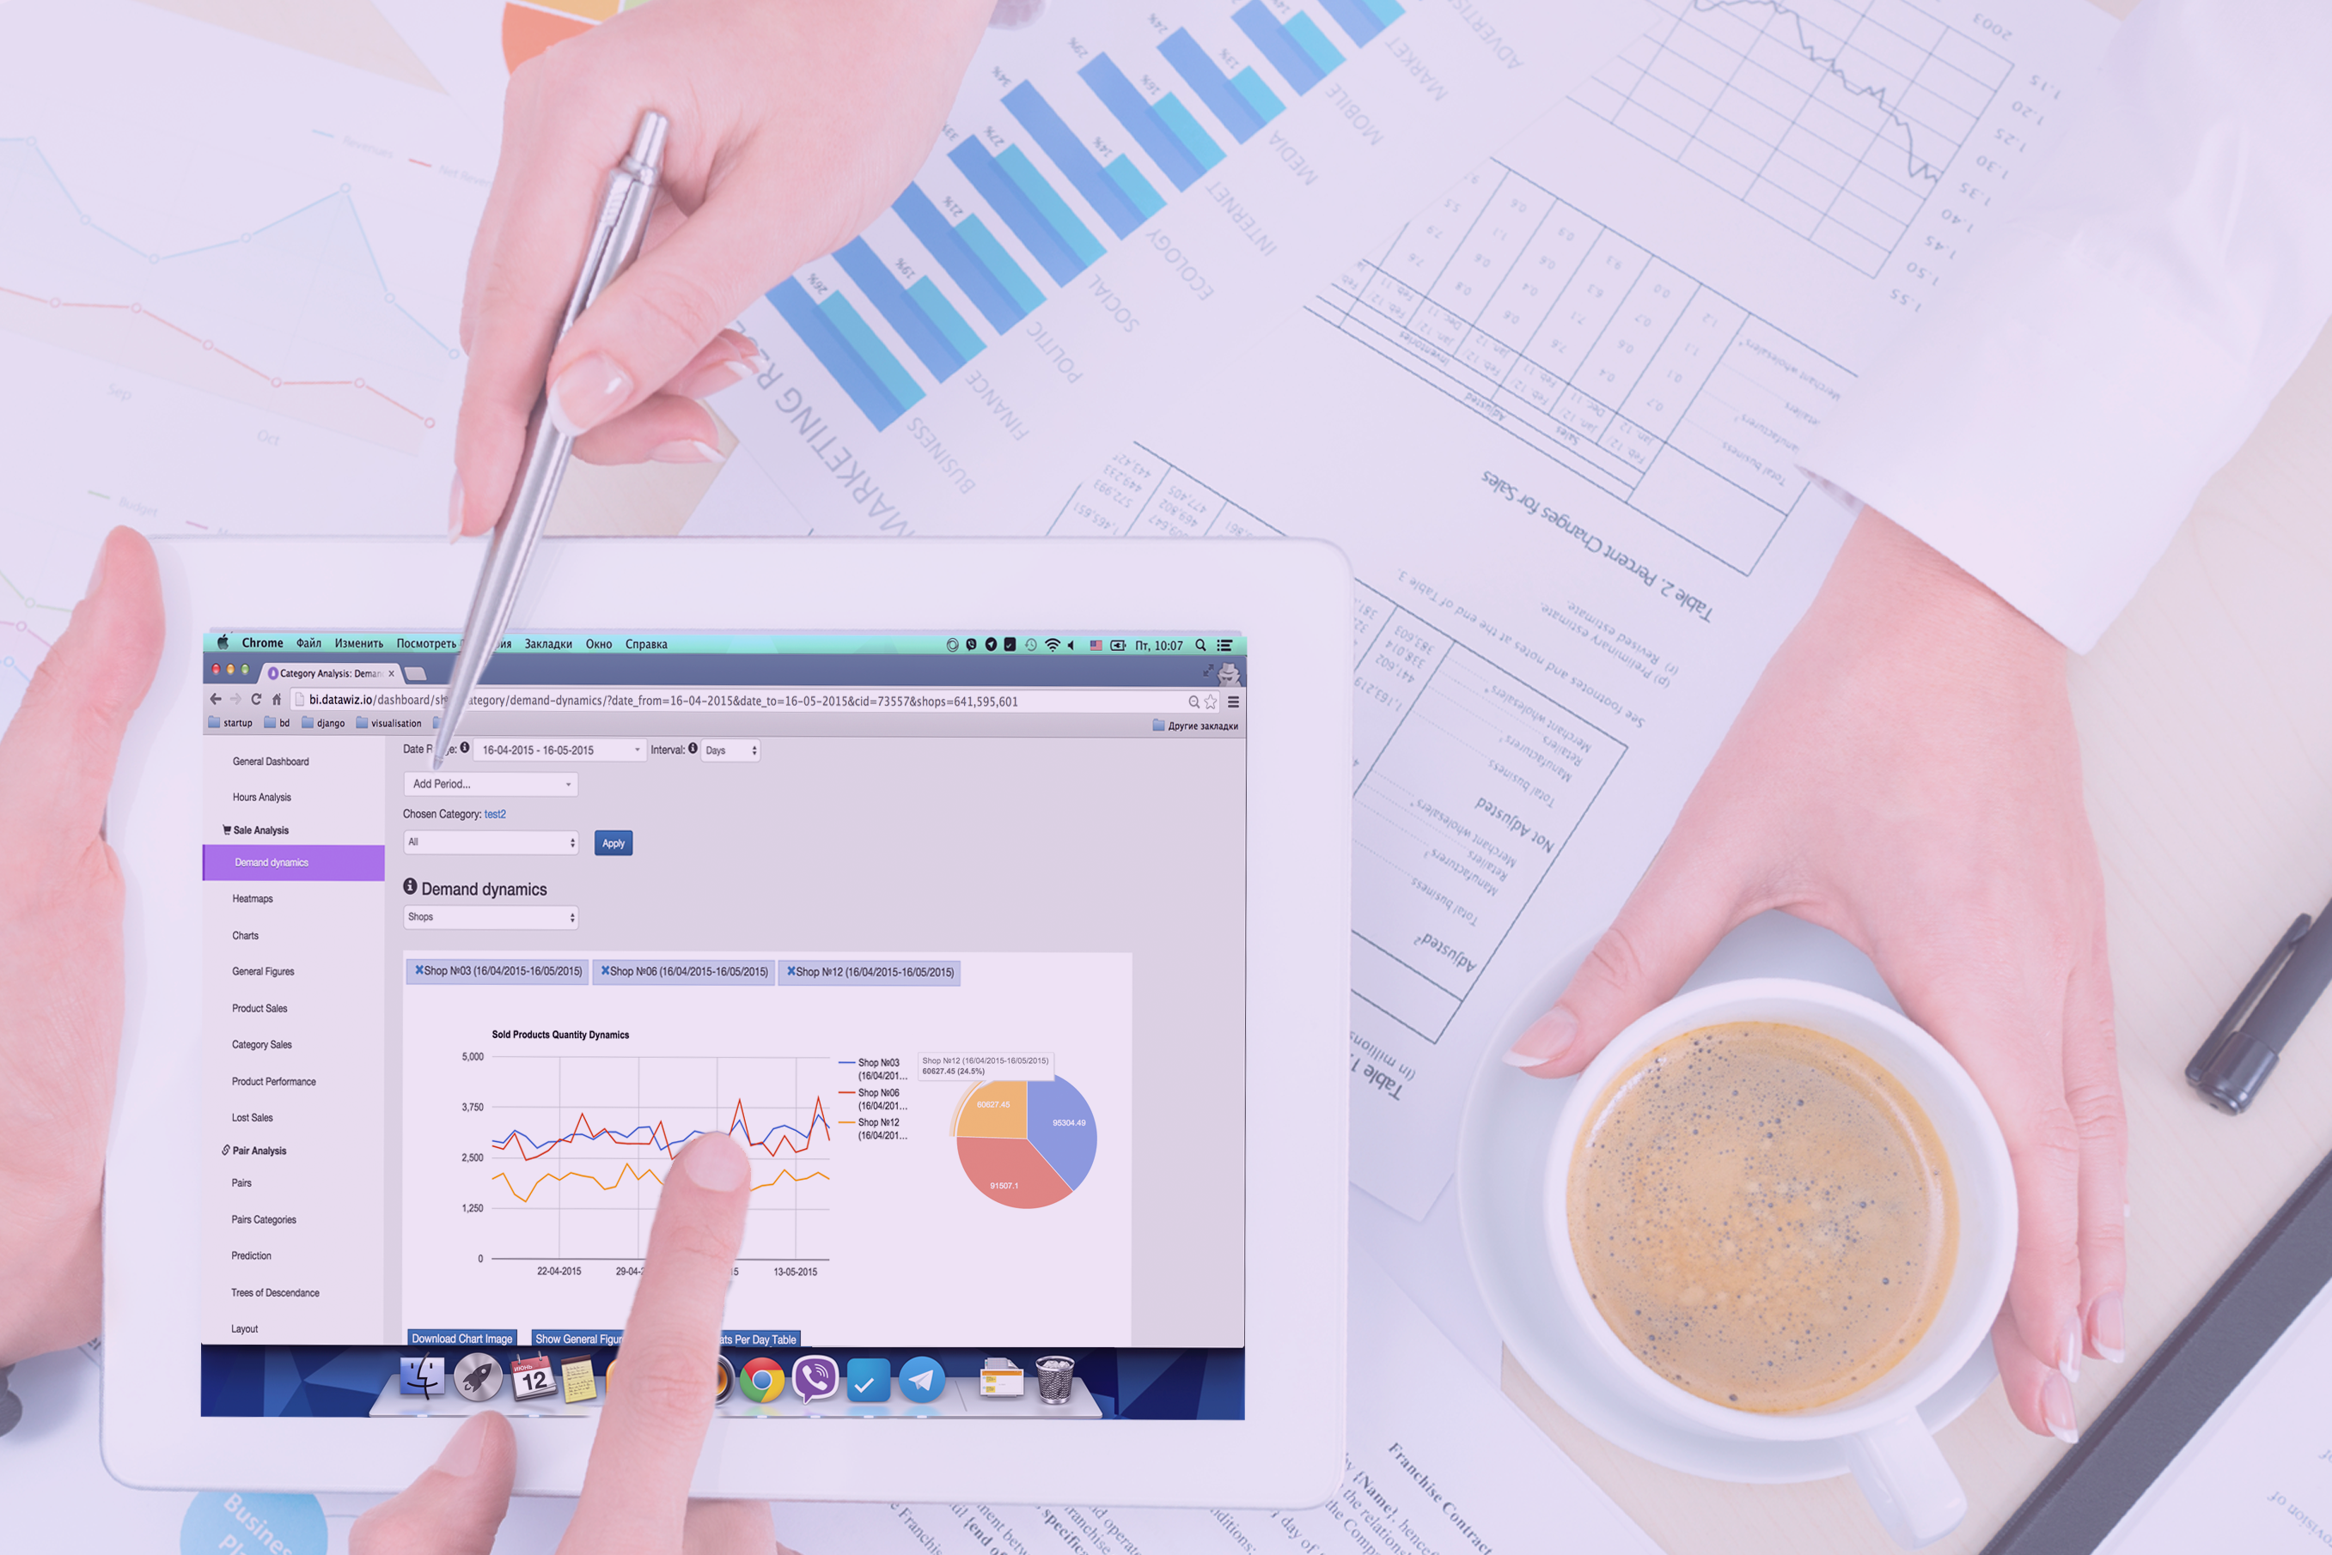
BI Datawiz.io
Business intelligence based on
real time transactional data

Slide 9
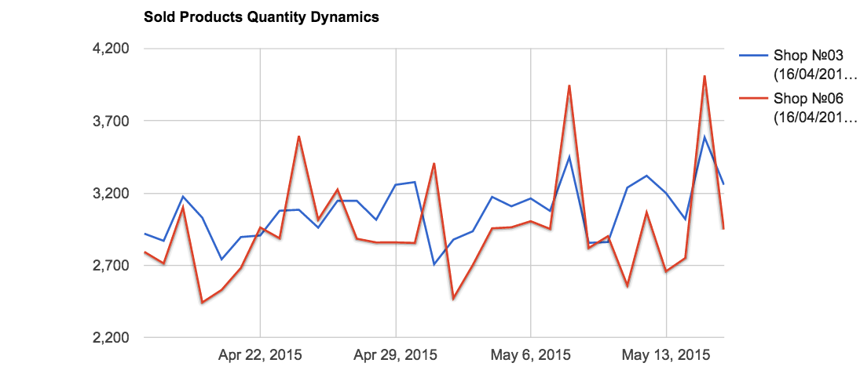
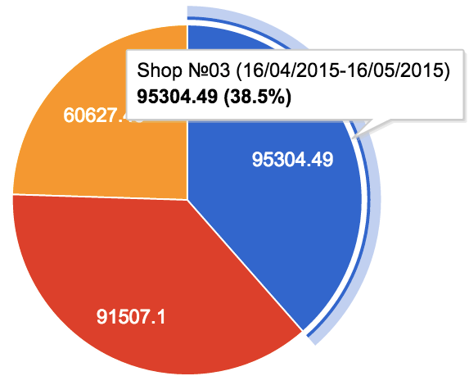
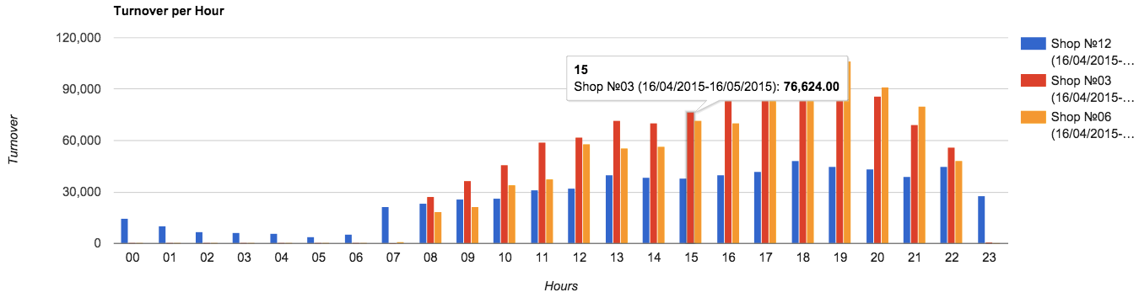
Visualization and stats of main retail KPI on one dashboard

Slide 10
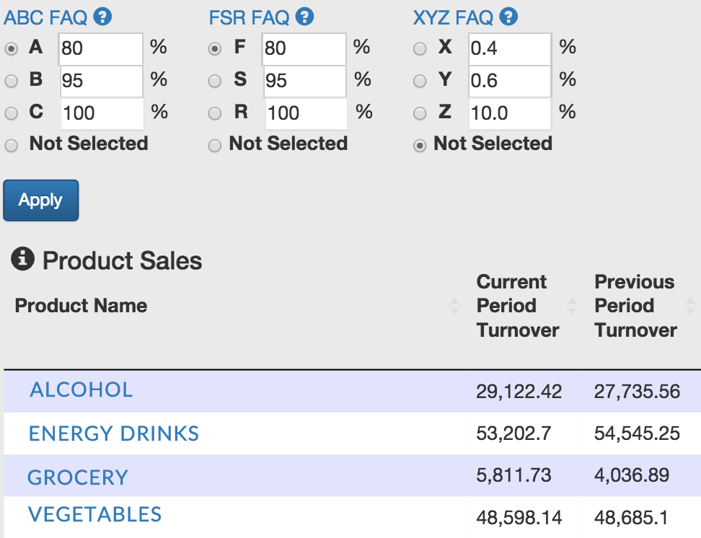
Most useful analysis (ABC, XYZ, FSR) for products performance optimization

Slide 11
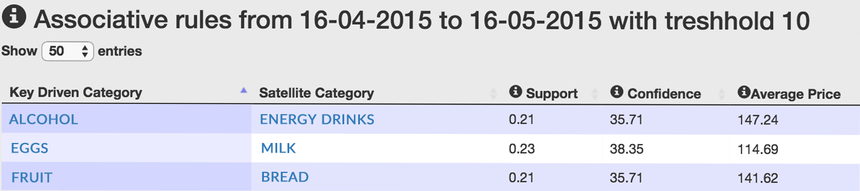
Deployment of Association Rules
Pair products that are often purchased together
Use pair products to make and execute promo complain

Slide 12
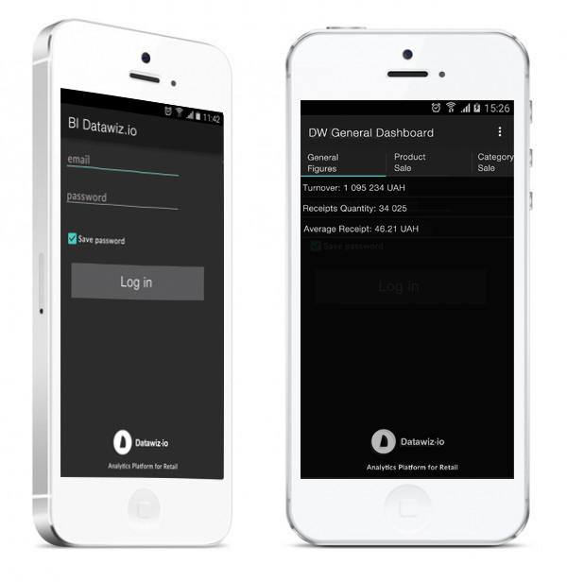
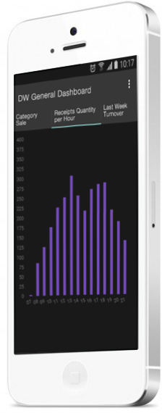
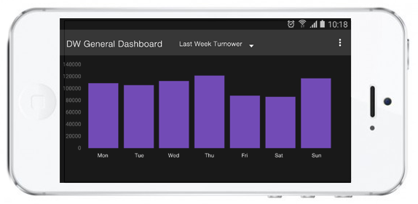
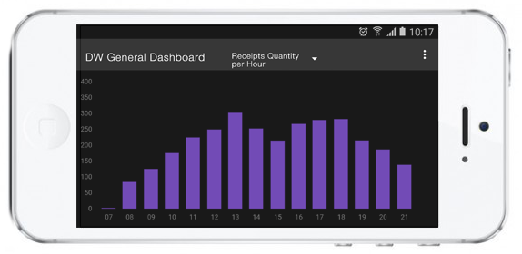
Datawiz Mobile Application
Get sale analytics on the phone

Slide 13
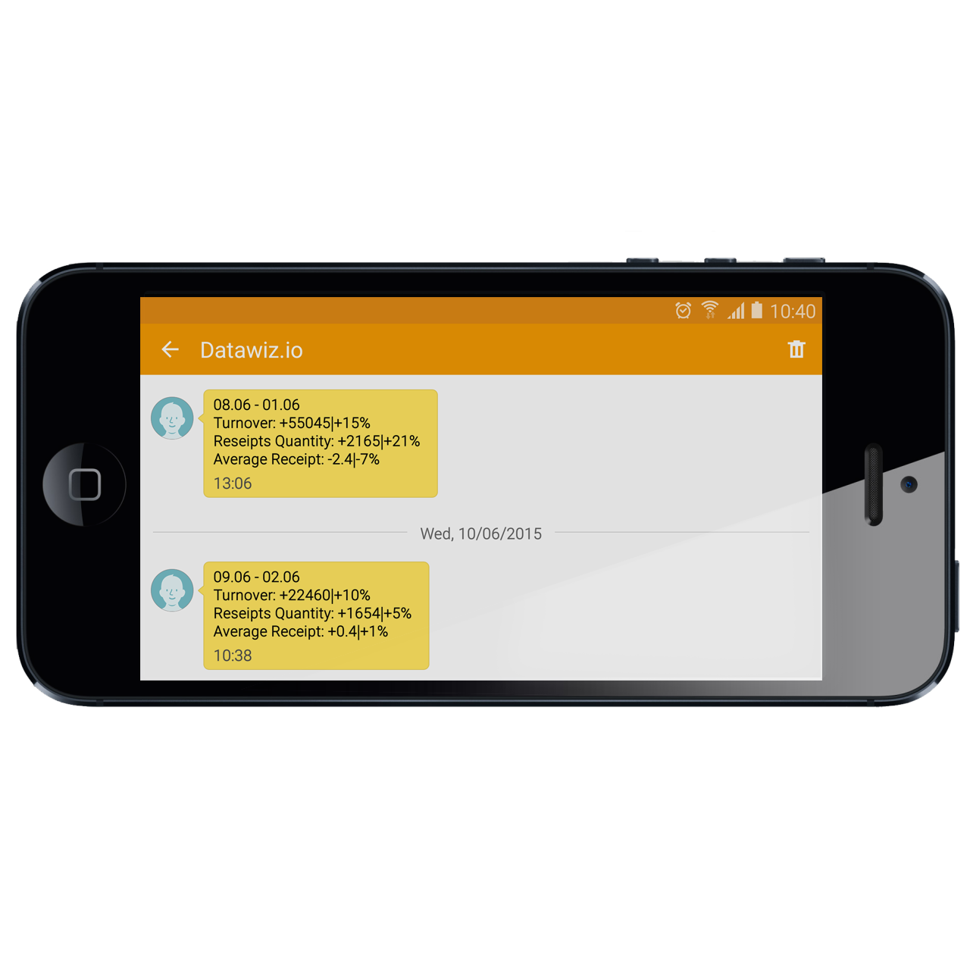
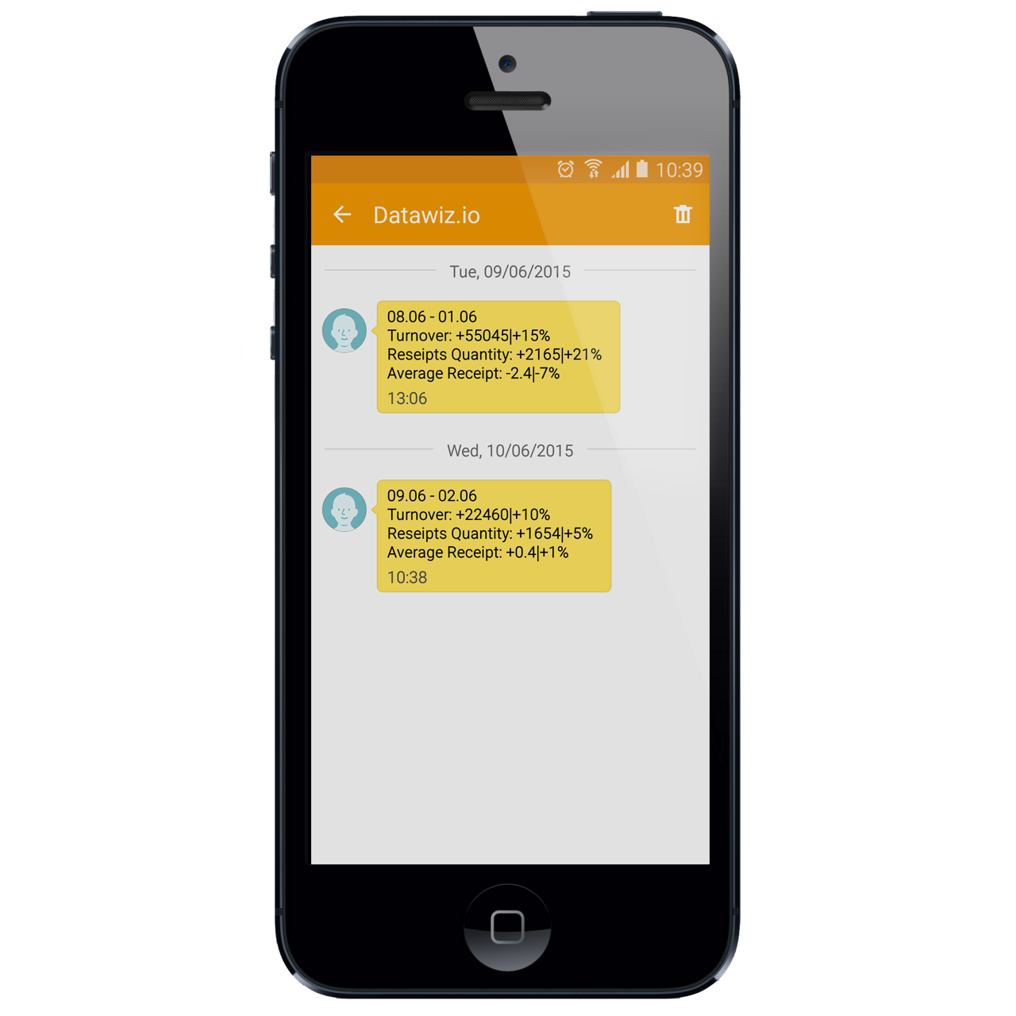
Get daily KPI reports by SMS

Slide 14
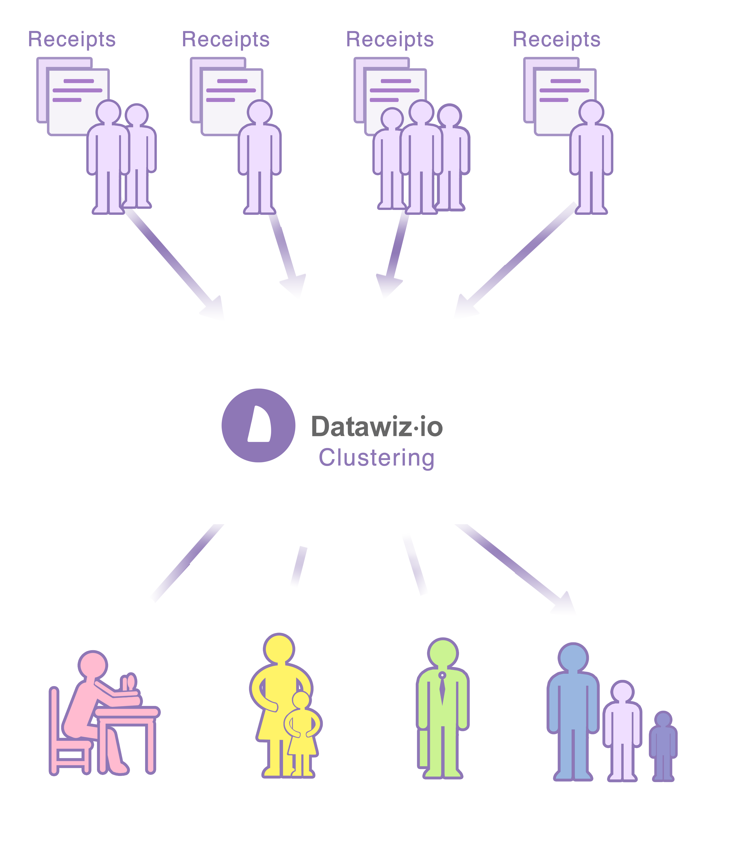
Datawiz Clustering
Use social demographic data to
define customer persona together with
his/her purchasing history.

Slide 15

Our Achievements
In less than 1.5 year, we
Launched product BI.datawiz.io
Launched product CL.datawiz.io
Built Mobile app for IPhone and Android
Connected more than 270 retail stores across Ukraine
Partner up with marketing agency like Avarla, Civitta, ZMK
Team of 11 specialists is formed
Built partnership with national university research center

Slide 16

Our customers segments
Small and middle size retail chains
Executive level
Marketing manager
Shop owner/manager
Retail Marketing/Consulting companies
Marketing researcher
Business trainer

Slide 17

Now we are working on
Creating automatic purchasing system
Optimizing stock products
Improving cash flow

Slide 18
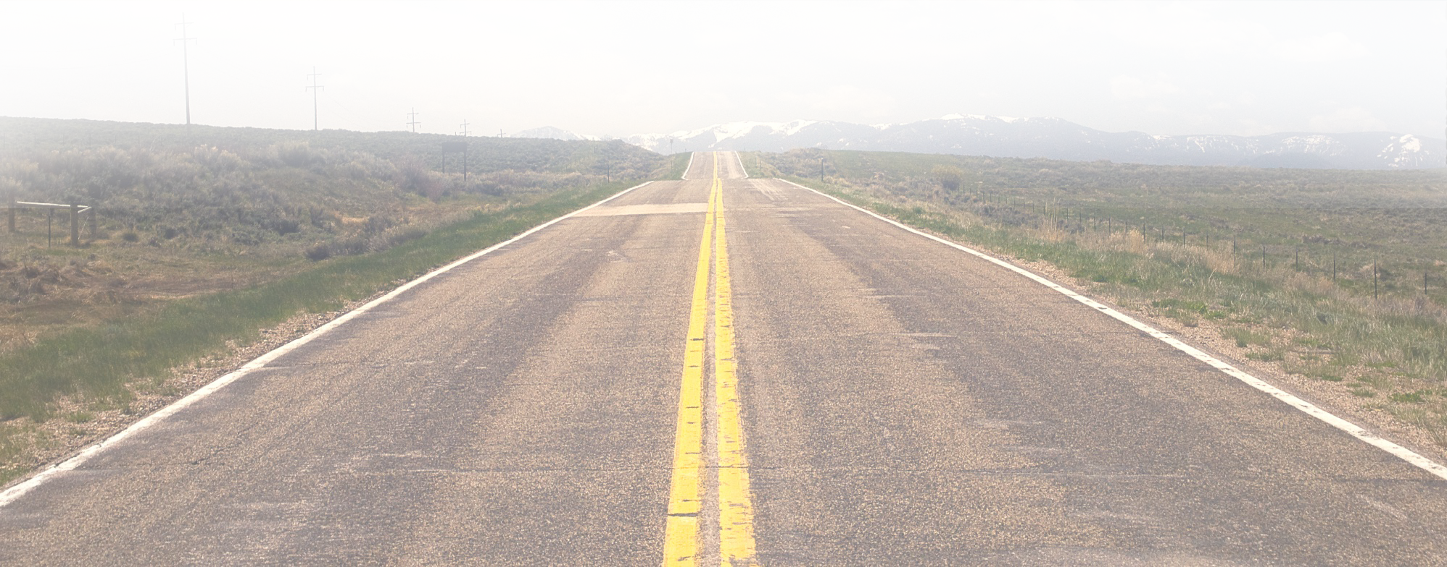
Where are we going?
Deep Deployment BigData tech in retail
In-depth coverage of Ukraine local market
Customer development in USA and China

Slide 19

YOUR CONCERN IS OUR RESPONSIBILITY
Datawiz Inc.
www.datawiz.io
1811 Silverside RD,
Wilmington, DE, 19810
United States
hello@datawiz.io

